Slide 1
Chemical Reactions and Equations
CHAPTER 1
Part 3- OXIDATION AND REDUCTION
Notes:
Lets start with our Chapter 1- that is Chemical Reactions and Equations

Slide 2
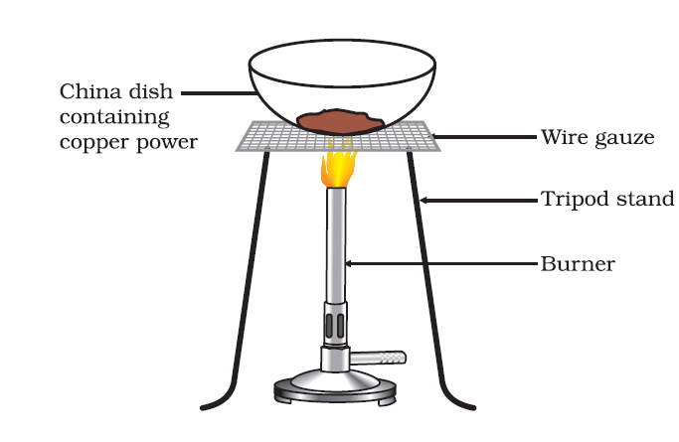
OXIDATION AND REDUCTION
ACTIVITY: OXIDATION OF COPPER TO COPPER OXIDE
Notes:
Here we see what is oxidation We take some copper powder in a china dish and heat it.
We observe that the surface of copper powder becomes black copper oxide.

Slide 3
Oxygen is added to copper and copper oxide is formed, the black coating is formed.
If hydrogen gas is passed over this heated material (CuO), the black coating on the surface turns brown as the reverse reaction takes place.
If a substance gains oxygen during a reaction, it is said to be oxidised.
If a substance loses oxygen during a reaction, it is said to be reduced.
2Cu(s)
+
O2(g)
2CuO(s)
CuO(s)
+
H2(g)
Cu(s)
+
H2O(g)

Slide 4
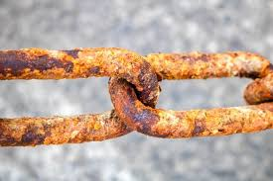
Effect of oxidation reactions in everyday life:
CORROSION
Metal getting corroded
Notes:
Lets see the description of these-
Corrosion
Corrosion is the process in which metals are eaten up gradually by the action of air, moisture or a chemical (such as an acid) on their surface.
Corrosion is caused mainly by the oxidation of metals by oxygen of air. Rusting of iron metal is the most common form of corrosion.
During the corrosion of iron (rusting of iron), iron metal is oxidized by the oxygen of air in the presence of water (moisture) to form hydrated iron (III) oxide called rust.
Corrosion weakens the iron and steel objects and structures such as railings, car bodies, bridges and ships, etc., and cuts short their life.

Slide 5
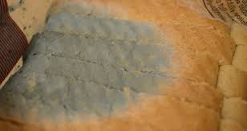
RANCIDITY
When bread is left at room for many days it get oxidised
Notes:
RANCIDITY:
When the fats and oils present in food materials get oxidized by the oxygen (of air), their oxidation products have unpleasant smell and taste.
The condition produced by aerial oxidation of fats and oils in foods marked by unpleasant smell and taste is called rancidity.
Rancidity spoils the food materials prepared in fats and oils which have been kept for a considerable time and make them unfit for eating.
The development of rancidity of food can be prevented or retarded (slowed down) in the following ways:
Rancidity can be prevented by adding anti-oxidants to foods containing fats and oils: Anti-oxidant is a substance (or chemical) which prevents oxidation. Anti-oxidants are actually reducing agent. The two common anti-oxidants used in foods to prevent the development of rancidity are BHA (Butylated Hydroxy – Anisole) and BHT (Butylated Hydroxy-Toluene).
Rancidity can be prevented by packaging fats and oils containing foods in nitrogen gas: When the packed is surrounded by unreactive gas nitrogen, there is no oxygen to cause its oxidation and make it rancid.

Slide 6
CONCLUSION
In this part we read about
Oxidation and Reduction
Oxidation reactions in daily life
Rancidity

